Slide 1
Integration of the Sales Force: An Empirical Examination
Erin Anderson and David C. Schmittlein
Rand Journal of Economics (1984)

Slide 2
Research Question/Problem Formulation
OVERARCHING QUESTION:
When does vertical integration occur?
SPECIFIC QUESTION:
Vertical integration of sales force
Whether to use an independent manufacturers' representative (market governance) or an “in-house" (employee) salesperson (hierarchical governance) to sell a product line
EMPIRICAL NOVELTY:
Unlike prior literature this research article focuses on human assets rather than physical assets
HISTORICAL CONTEXT:
1974: 50% of sales operations in all industries used the market (manufacturers’ reps)
1977: However, only 10% of U.S. dollar volume in 15 industry categories used the market via reps.

Slide 3
TCE-Based Hypotheses
ASSET SPECIFICITY:
The knowledge and relationships our salesperson eventually acquires concerning firm A are assets specific to firm A, which results in bilateral exchange relationships.3
The greater the total value of company-specific assets (on the company and customer sides), the greater the likelihood of vertical integration in the form of an in-house sales force.
Measurement of Transaction Specificity of Assets (TSA): (i) nature of the company and difficulty in learning the in and outs of the firm; (ii) nature of the product and the amount of needed extra training in this firm by a new salesperson; (iii) confidential information held by the salesperson; (iv) nature of the customer taking time to develop; (v) importance of key accounts that are given special attention; and (vi) customer loyalty based on personal relationships with the salsesperson.

Slide 4
TCE-Based Hypotheses
UNCERTAINTY:
Environmental unpredictability: contract renegotiation costs
The likelihood of integration is expected to increase, given non-trivial asset specificity, with increasing environmental uncertainty.
Measurement: Expected deviation between forecast and actual sales in the next year
Difficulty of evaluating performance:
1) The infeasibility to record each salesperson’s results accurately.
2) Responsibility for a sale may not be assignable to an individual (non-separability)
3) “Performance" may not be a simple, readily measurable scalar.
The likelihood of integration is expected to increase with the difficulty of evaluating performance.
Measurement: semantic differential in response to "It is very difficult to measure equitably the results of individual salespeople." (UDEP)

Slide 5
TCE-Based Hypotheses
FREQUENCY:
A specialized governance mechanism involves significant setup and maintenance costs
Firm must at least break even on the fixed cost of the integration function
The likelihood of vertical integration is expected to increase as territorial density (TD) increases
Measurement: Negative of the percentage of salespersons' time spent driving or flying, i.e., the less time spent traveling, the denser the territory
FIRM SIZE:
Economies of scale, economies of scope, market power, the ability to aggregate inputs
The greater the firm size, the greater the likelihood of vertical integration in the form of an in-house sales force.
Measurement: 1980 company assets in dollars (SIZE)

Slide 6
Data and Model
Survey data from the electronic components industry (16 companies)
Unit of analysis: the product line of a given company and territory
The survey respondents are territory sales managers
Asset specificity, environmental uncertainty, difficulty in evaluating performance, territory density, company size (assets in $) are hypothesized to have a positive effect on the likelihood of using a corporate sales personnel (i.e., vertical integration).
Interaction terms: asset specificity/environmental uncertainty (ZUESTA) and asset specificity/difficulty in evaluating performance (ZUDEPSTA)
The logistic response function (logit model) (Domencich & McFadden, 1975).
The coefficients were estimated by maximizing the likelihood function (the Gauss-Newton non-linear least squares method)

Slide 7
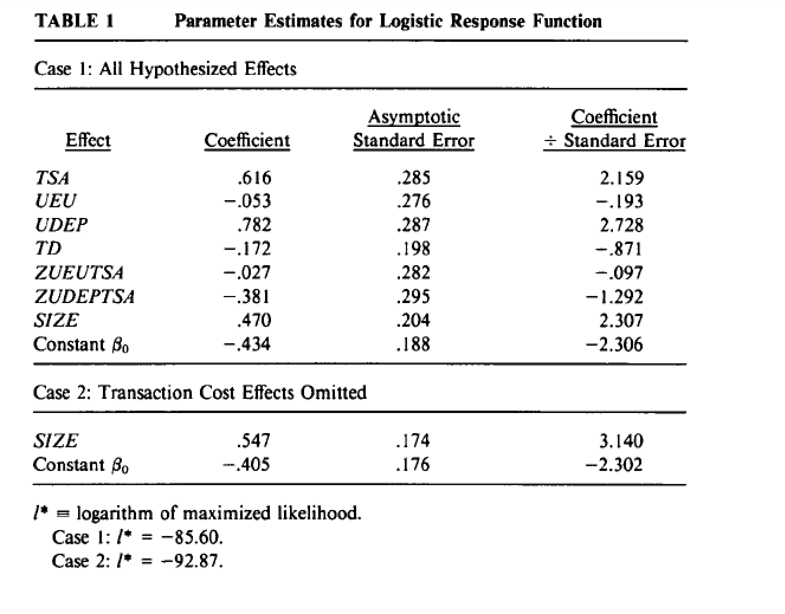
RESULTS
Empirical Results: ALL EFFECTS
Asset Specificity (TSA), Difficulty of Evaluating Performance (UDEP) , and Company Size (SIZE) have the hypothesized (positive) effect on the probability of using an in-house corporate sales force and are statistically significant.
Contrary to predictions of transaction costs theory, the expected specificity and uncertainty interactions were not corroborated empirically.

